Slide 1






Enhanced environmental protection inspection for efficient control of air quality monitoring and of all entities under obligation within system of greenhouse gas emission allowance trading, in order to achieve better quality of air in Republic of Croatia
This project is funded by the European Union

Slide 2



THEME 1: Pollution of the atmosphere

Slide 3


1.8 THE TEMPORAL AND SPATIAL DISTRIBUTION OF POLLUTANTS
European Union IPA 2013 Programme for Croatia
Levels of pollutants vary in time and with respect to the geographical location. Such variations are dependent on various factors:
distribution and activity of emission sources
meteorological parameters
chemical reactions and transformations that are occurring during transport of pollutants

Slide 4
1.8 THE TEMPORAL AND SPATIAL DISTRIBUTION OF POLLUTANTS
European Union IPA 2013 Programme for Croatia
Pollutant sources have also been evaluated differently. Most attention is paid to pollutants of anthropogenic origin emitted from industrial plants and households (black smoke and SO₂) and from traffic (floating particles PM_{2.5}, volatile organic compounds VOC, nitrogen oxides NOx and carbon monoxide CO) (Table 1) . It should also be recalled that many secondary pollutants are created in the atmosphere. The results of such reactions are particles (including sulfates and nitrates) and ozone (O₃).

Slide 5
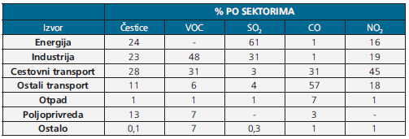
1.8 THE TEMPORAL AND SPATIAL DISTRIBUTION OF POLLUTANTS
European Union IPA 2013 Programme for Croatia
The emission sources of pollutants in Europe.
Source
Particles
Energy
Industry
Road transport
Other transport
Waste
Agriculture
Other
Source: European Environment Agency

Slide 6
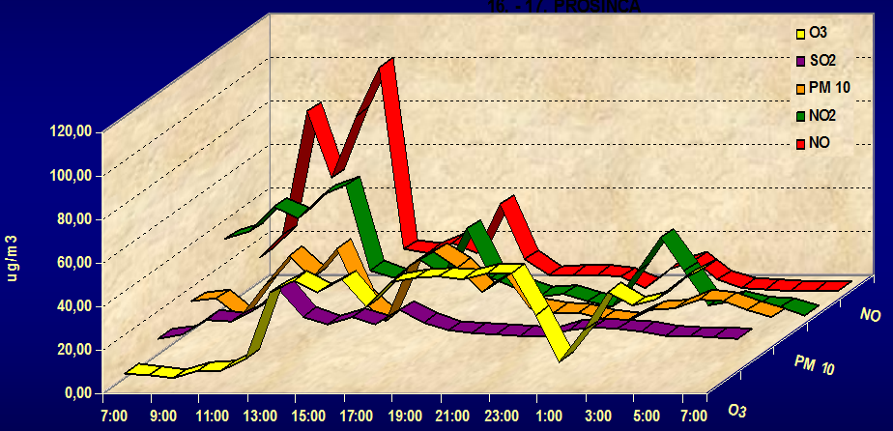
1.8 THE TEMPORAL AND SPATIAL DISTRIBUTION OF POLLUTANTS
European Union IPA 2013 Programme for Croatia
Temporal distribution of pollutants is different among the types of emissions sources.
Example 1.
Pollutants emitted by motor vehicles have characteristic morning and afternoon peak concentration (going to work and coming from work). The lowest concentration are in the night hours.

Slide 7
1.8 THE TEMPORAL AND SPATIAL DISTRIBUTION OF POLLUTANTS
European Union IPA 2013 Programme for Croatia
Example 2.
Emissions of pollutants from heat stations and thermal power plants have small short-term variation, but they have great seasonal variation. In the winter period have maximum, and the minimum in summer.
The influence of height of emission sources to the distribution of pollutants in the air
Industrial pollution due to discharges of pollutants through high chimneys are easier to scatter in the higher layers of the troposphere than those from the chimneys of households. The lowest, next to the ground, they emit the pollutants from motor vehicles, and therefore represent the largest public health problem, because they have the most influence on human health in urban environments.

Slide 8
1.8 THE TEMPORAL AND SPATIAL DISTRIBUTION OF POLLUTANTS
European Union IPA 2013 Programme for Croatia
Influence of atmospheric and meteorological conditions on the distribution of pollutants
In cases of high exhaust pollutants, launching major air masses regulates their transport over long distances.
Example 1.
Many serious episodes of pollution in northern Europe come from pollutants from the industrial areas of Central Europe and the Ruhr valley.
Reason: Because of north wind and anti-cyclonal systems that transport pollutants at elevations of 8 km to 14 km.

Slide 9
1.8 THE TEMPORAL AND SPATIAL DISTRIBUTION OF POLLUTANTS
European Union IPA 2013 Programme for Croatia
Influence of atmospheric and meteorological conditions on the distribution of pollutants
Local, directions and wind speed will significantly contribute to the variations of the concentration of ground pollutants.
In large urban areas a high building also has an impact on the distribution of pollutants that are spread along the street.
In such urban areas where is heavy traffic, dominate nitrogen oxide (NO), which in the presence of ground-level ozone is converted to nitrogen dioxide (NO₂).

Slide 10
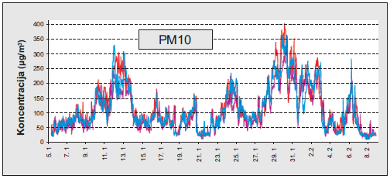
1.8 THE TEMPORAL AND SPATIAL DISTRIBUTION OF POLLUTANTS
European Union IPA 2013 Programme for Croatia
Short-term variations in levels of pollutants in the air
Short-term variations in levels of pollutants in the air are very large, and they relate to variations
FROM A FEW MINUTES TO A FEW HOURS
Example:
Hourly concentrations of PM10 vary, such as for example:
the current number of cars on the road
the speed at which the traffic carried
the direction and speed of the wind

Slide 11
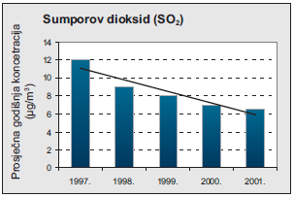
1.8 THE TEMPORAL AND SPATIAL DISTRIBUTION OF POLLUTANTS
European Union IPA 2013 Programme for Croatia
Long-term level trends of pollutants in the air
Long-term trends in the level of pollutants in the air are related to monitoring the concentrations of several years
Example:
The negative trend of the concentration of SO₂ in the air in the period of 2001-1997. The results of measurement at a measuring station AirBasea in Europe. Source: AIRNET

Slide 12
1.8 THE TEMPORAL AND SPATIAL DISTRIBUTION OF POLLUTANTS
European Union IPA 2013 Programme for Croatia
Spatial distribution of pollutants in the air
Spatial distribution of pollutants in the air depends on the:
Topographic characteristics of the terrain
EMISSION SOURCES (urban, rural)
For many pollutants such as SO₂, NO, NO₂, CO and VOC main determinants of spatial and temporal variations are:
THE ACTIVITY OF THE EMISSION SOURCE
DISTANCE FROM THE SOURCE OF EMISSION

Slide 13
1.8 THE TEMPORAL AND SPATIAL DISTRIBUTION OF POLLUTANTS
European Union IPA 2013 Programme for Croatia
Spatial distribution of pollutants in the air (continued)
For ground level ozone (O₃) and particulate are:
CHEMICAL REACTIONS IN THE ATMOSPHERE
Time and space, act on the variations of the concentration of pollutants in the air.

Slide 14
1.9 METASTUDIES-NATIONAL AIR QUALITY STANDARDS
European Union IPA 2013 Programme for Croatia
The meta-studies are major projects that combine many toxicological and epidemiological studies.
So in the 1990s, the European Union funded two studies like these:
1 APHEA (Air Pollution and Health: a European Approach) that is on more than 25 million people in 15 European cities studied the short-term effects of exposure (several days) of increased air pollution to people's health and the impact on public health
https://www.ncbi.nlm.nih.gov/pubmed/10730486

Slide 15
1.9 METASTUDIES-NATIONAL AIR QUALITY STANDARDS
European Union IPA 2013 Programme for Croatia
APHEA 2 which is in 8 European cities linked episodes of excessive air pollution with increasing admission of pulmonary patients in the hospital.
https://abdn.pure.elsevier.com/en/publications/acute-effects-of-particulate-air-pollution-on-respiratory-admissi

Slide 16
1.9 METASTUDIES-NATIONAL AIR QUALITY STANDARDS
European Union IPA 2013 Programme for Croatia
Certainly the most well-known meta-studies of the PKZ area are those that have since World Health Organization (WHO) been periodically formulated since 1957 and may be placed under the common name "WHO Air Quality Guidelines“.
This publication are used for decades as reference documents in the development of strategies and policies in the area of air quality in many countries around the world.
An overview of all the studies from 1957 to 2006 can be found at:
http://www.euro.who.int/__data/assets/pdf_file/0019/331660/Evolution-air-quality.pdf

Slide 17

1.9 METASTUDIES-NATIONAL AIR QUALITY STANDARDS
European Union IPA 2013 Programme for Croatia
For the participants of this training course, we recommend the two most recent publications of the WHO Air quality guidelines ".
„WHO Air quality guidelines for Europe ; second edition 2000”.
http://www.euro.who.int/en/health-topics/environment-and-health/air-quality/publications/pre2009/air-quality-guidelines-for-europe
In it you can find everything you will ever need to know in this area. The bulk of the second topic of these "Pollutants" lectures was derived from this publication, which deals with a large number of pollutants from the chemical, toxicological and public health aspects, and provides recommended levels of pollution for individual pollutant.

Slide 18

1.9 METASTUDIES-NATIONAL AIR QUALITY STANDARDS
European Union IPA 2013 Programme for Croatia
The second and most recent WHO AQG publication is "Air Quality Guidelines. Global update 2005. Particulate matter, ozone, nitrogen dioxide and sulfur dioxide
http://www.euro.who.int/en/health-topics/environment-and-health/air-quality/publications/pre2009/air-quality-guidelines.-global-update-2005.-particulate-matter,-ozone,-nitrogen-dioxide-and-sulfur-dioxide
It treats the above mentioned pollutants in the same way by providing the latest evidence of the impact of atmospheric pollution on humans. It also gives the recommended levels of contamination.

Slide 19
1.9 METASTUDIES-NATIONAL AIR QUALITY STANDARDS
European Union IPA 2013 Programme for Croatia
So called air quality guidelines are the values of concentrations of pollutants in the air (with varying averaging times) that have been shown not to harm human health throughout life.
From these values were created and the limit values of air pollution in the European and Croatian regulations.
Commission Directive (EU) 2015/1480, Directive 2008/50/EC and Directive 2004/107/EC
Regulation on levels of pollutants in the air (NN 117/12, 84/17)

Slide 20
1.10 GLOBAL PROBLEMS CAUSED BY AIR POLLUTION
European Union IPA 2013 Programme for Croatia
Acidification of the atmosphere - acid precipitation
Acid precipitation are defined as precipitation whose acidity has a pH value less than 5.6.
Acidic can be various types of precipitation: rain, snow, sleet, hail, but they can also be gases, mist and floating particles in the troposphere.
Since the appearance of humans on Earth acidity precipitation varied due to time and space. In the 19th century, English chemist Robert Angus Smith first measured the acidity and content of sulfate in the rains of England, Scotland and Germany and was therefore named "the father of acid rain".

Slide 21
1.10 GLOBAL PROBLEMS CAUSED BY AIR POLLUTION
European Union IPA 2013 Programme for Croatia
Acidification of the atmosphere - acid precipitation
The results of his measurements in 1872, Smith associated with variations of regional factors such as:
combustion of coal
the directions of the wind blowing
the amount and frequency of precipitation
He was also determined that the more acidic rain in those where there is a greater concentration of sulphate adversely affect trees and cereals on which spotted the damage.

Slide 22
1.10 GLOBAL PROBLEMS CAUSED BY AIR POLLUTION
European Union IPA 2013 Programme for Croatia
Acidification of the atmosphere - acid precipitation
Smith's discovery was not seriously taken into account, so they remained in oblivion for a century while Norway did not launch an interdisciplinary research project aimed at identifying the effects of acid rainfall on forest and water ecosystems.
It has been established that in the period from 1940. to 1980. gone half of the fish population due to the adverse impact of the acidification of terrestrial water streams.

Slide 23
1.10 GLOBAL PROBLEMS CAUSED BY AIR POLLUTION
European Union IPA 2013 Programme for Croatia
Acidification of the atmosphere - acid precipitation
Similar surveys are done in Sweden, and the results are more than disturbing. Namely, 18 000 Swedish lake water has a pH less than 5.5, which has incalculable ecological consequences for the wildlife in them.
In recent history, the pH value of lake water in some parts of the United States is less than 3 and the rainfall in Europe has fallen over Scotland in 1974 had a pH value of 2.4.

Slide 24
1.10 GLOBAL PROBLEMS CAUSED BY AIR POLLUTION
European Union IPA 2013 Programme for Croatia
Acidification of the atmosphere - acid precipitation
Sources of acid precipitation
Acid precipitates are formed in the atmosphere from sulfur dioxide (SO₂), nitrogen oxides (NOx) and carbon dioxide (CO₂) whose sources can be natural and anthropogenic.
Looking globally, emissions from natural sources make up a share of 60%, while the share from anthropogenic sources 40%.
Natural sources of sulfur are marine aerosols that contain sulfates, volcanic eruptions, which release high amounts of hydrogen sulphide (H₂S) and sulfur released into the atmosphere during bacterial degradation of organic matter.

Slide 25
1.10 GLOBAL PROBLEMS CAUSED BY AIR POLLUTION
European Union IPA 2013 Programme for Croatia
Acidification of the atmosphere - acid precipitation
Sources of acid precipitation
combustion of fossil fuels (coal, oil and natural gas), industrial processes (primary metal production) and thermal power plants
the marine aerosol (sulphates), volcanic eruptions (H₂S), bacterial degradation of organic matter (S)
NATURAL SOURCES

Slide 26
1.10 GLOBAL PROBLEMS CAUSED BY AIR POLLUTION
European Union IPA 2013 Programme for Croatia
Acidification of the atmosphere - acid precipitation
Sources of acid precipitation
Gases and particles from the atmosphere are deposited on the land as acid precipitates with the help of two atmospheric processes:
absorption of gases in the condensed water inside the steam clouds which then, in the form of acidic precipitation falling on the ground (the rainout)
absorption of gases in droplets below the clouds where the gases acidify precipitation after leaving the clouds (washout)

Slide 27
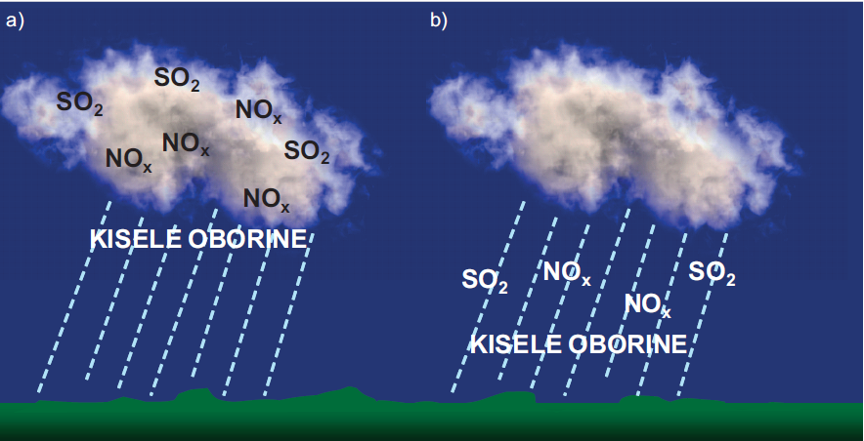
1.10 GLOBAL PROBLEMS CAUSED BY AIR POLLUTION
European Union IPA 2013 Programme for Croatia
Acidification of the atmosphere - acid precipitation
Sources of acid precipitation
ACID PRECIPITATION
ACID PRECIPITATION
RAINOUT
WASHOUT
The two processes are related to the «wet» disposal of acid substances to the surface of the Earth.

Slide 28
1.10 GLOBAL PROBLEMS CAUSED BY AIR POLLUTION
European Union IPA 2013 Programme for Croatia
Acidification of the atmosphere - acid precipitation
Sources of acid precipitation
There is also so called. «dry» disposal of pollutants on the surface of the Earth. It occurs in the absence of precipitation, at in three ways:
absorption of gases in the surface water or soil
by gravitational sedimentation of larger particles
direct contact with smaller particles with vegetation and other surfaces

Slide 29
1.10 GLOBAL PROBLEMS CAUSED BY AIR POLLUTION
European Union IPA 2013 Programme for Croatia
Acidification of the atmosphere - acid precipitation
Sources of acid precipitation
Unpolluted rain is lightly acidic and has a pH range of 5.6 to 6.5.
The reason is that carbon dioxide (CO₂) from the atmosphere is dissolved in water from the atmosphere creating carbonic acid. However, when the polluting gases (SO₂ and NOx) from the atmosphere dissolved in water, the acidity of rainfall substantially increase.

Slide 30
1.10 GLOBAL PROBLEMS CAUSED BY AIR POLLUTION
European Union IPA 2013 Programme for Croatia
Acidification of the atmosphere - acid precipitation
Sources of acid precipitation
Example:
When measuring the acidity of rain in North America, the pH of the rain amounted to 3.0 (which is the acidity of vinegar). The lowest values of acid rain in the North of the USA were measured in November 1964. amounted to 2.1, while in Europe the lowest value was recorded in the rain that is falling over the Scotland 1974. and amounted to 2.4.

Slide 31
1.10 GLOBAL PROBLEMS CAUSED BY AIR POLLUTION
European Union IPA 2013 Programme for Croatia
Acidification of the atmosphere - acid precipitation
Sources of acid precipitation
When one pollutant comes into the atmosphere, its destiny depends on physical processes:
dispersing
transport
deposition
and the complex chemical reactions that occur in the time between the emission and deposition on the surface of the Earth.

Slide 32
1.10 GLOBAL PROBLEMS CAUSED BY AIR POLLUTION
European Union IPA 2013 Programme for Croatia
Acidification of the atmosphere - acid precipitation
Chemistry of acidic precipitation
Factors that influence the fate of pollutants include:
the height of the emission
the amount of Solar radiation
the presence of precipitation
the composition of the Earth's surface
The sulfur from the fuel and nitrogen, before they become acid, they enter into a series of chemical reactions in the atmosphere.

Slide 33
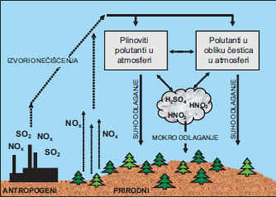
1.10 GLOBAL PROBLEMS CAUSED BY AIR POLLUTION
European Union IPA 2013 Programme for Croatia
Acidification of the atmosphere - acid precipitation
Chemistry of acidic precipitation
Gaseous pollutants in the atmosphere
Pollutants in the form of particles in the atmosphere
The physical and chemical processes in creation of acid precipitation
SOURCES OF POLLUTION
Dry deposition
Dry deposition
Wet deposition
ANTHROPOGENIC
NATURAL

Slide 34
1.10 GLOBAL PROBLEMS CAUSED BY AIR POLLUTION
European Union IPA 2013 Programme for Croatia
Acidification of the atmosphere - acid precipitation
SO₂ and combustion of coal
Coal (fossil fuel) is chemically very different, but they share the following constituent elements: carbon (C), hydrogen (H), oxygen (O), nitrogen (N) and sulphur (S).
In addition to the above mentioned elements, in very small quantities of coal also contains sodium (Na), calcium (Ca), aluminium (Al), nickel (Ni), copper (Cu), arsenic (As), lead (Pb) and mercury (Hg).
Approximate formula of coal is C₁₃₅H₉₆O₉NS

Slide 35
1.10 GLOBAL PROBLEMS CAUSED BY AIR POLLUTION
European Union IPA 2013 Programme for Croatia
Acidification of the atmosphere - acid precipitation
SO₂ and combustion of coal
Combustion of coal is coming to the oxidation of all the elements in it, and since they are C and H, the most created a large amount of CO₂ and H₂O, but also a certain amount of SO₂.
Released into the atmosphere, sulfur (S) reacts with oxygen (O₂) and produced sulphur dioxide (SO₂):
S + O₂ SO₂

Slide 36
1.10 GLOBAL PROBLEMS CAUSED BY AIR POLLUTION
European Union IPA 2013 Programme for Croatia
Acidification of the atmosphere - acid precipitation
SO₂ and combustion of coal
Sulphur dioxide (SO₂) in the atmosphere is oxidized, and as a product of the reaction is formed sulphur trioksid (SO₃). This reaction is relatively slow, but if there are particles floating in the atmosphere, such as for example. the ashes, then the reaction speeds up because the ash acts as a catalyst:
2SO₂ + O₂  2SO₃

Slide 37
1.10 GLOBAL PROBLEMS CAUSED BY AIR POLLUTION
European Union IPA 2013 Programme for Croatia
Acidification of the atmosphere - acid precipitation
SO₂ and combustion of coal
Sulfur trioxide SO₃ in the atmosphere reacts with droplets of water (H₂O) and sulfuric acid (H₂SO₄) is formed:
SO₃ + H₂O  H₂SO₄
In addition to the before mentioned reactions in which sulfuric acid is produced, there are other ways of its formation. One of them is the formation of a hydroxyl radical (OH *). The hydroxyl radical is generated by a photochemical process from the tropospheric ozone in reaction with water molecules. The reaction of SO₂ with a hydroxyl radical is formed 20 to 25% sulfuric acid in the atmosphere.

Slide 38
1.10 GLOBAL PROBLEMS CAUSED BY AIR POLLUTION
European Union IPA 2013 Programme for Croatia
Acidification of the atmosphere - acid precipitation
NO₂ and combustion of fuel in car engines
The most nitric dioxide (NO₂) emitted from the exhaust gases from automobile engine, so the concentration of this gas in the atmosphere directly associated with the density of the traffic. For this reason we say that the NO₂ is indicator of traffic. But the question is how is nitrogen found in exhaust fumes when it was known that the petrol does not contain nitrogen?

Slide 39
1.10 GLOBAL PROBLEMS CAUSED BY AIR POLLUTION
European Union IPA 2013 Programme for Croatia
Acidification of the atmosphere - acid precipitation
NO₂ and combustion of fuel in car engines
The answer is very simple. Nitrogen is an integral part of the air and represented about 78% in the air. Nitrogen molecules (N₂) in the air are very stable and poorly reactive at normal temperatures, but at elevated temperatures that are created in the automotive engine at ignition of the mixture of fuel and air, nitrogen from the air are oxidized to nitric oxide (NO):
N₂ + O₂ 2NO
ENERGY

Slide 40
1.10 GLOBAL PROBLEMS CAUSED BY AIR POLLUTION
European Union IPA 2013 Programme for Croatia
Acidification of the atmosphere - acid precipitation
NO₂ and combustion of fuel in car engines
Nitric oxide (NO) in atmosphere is oxidised and is formed nitrogen dioxide (NO₂):
2NO + O₂ 2NO₂
From nitric dioxide (NO₂) in the reaction with water (H₂O) are formed nitrous (HNO₂) and nitric (HNO₃) acid:
2NO₂ + H₂O HNO₂ + HNO₃

Slide 41
1.10 GLOBAL PROBLEMS CAUSED BY AIR POLLUTION
European Union IPA 2013 Programme for Croatia
Acidification of the atmosphere - acid precipitation
NO₂ and combustion of fuel in car engines
Nitric acid, other than in the above mentioned processes, can arise and in the reaction of hydroxyl radicals (OH *) with (VOC) in the following reaction:
NO₂ + OH* HNO₃
Since HNO₃ in water is completely dissociated to hydrogen (H ⁺) and nitrate (NO₃) ions, the result is an alarming drop in pH value (high acidification) of precipitation:
HNO₃ H⁺ + NO₃⁻

Slide 42
1.10 GLOBAL PROBLEMS CAUSED BY AIR POLLUTION
European Union IPA 2013 Programme for Croatia
Acidification of the atmosphere - acid precipitation
Effects of acidic precipitation on the soil
The effect of acid rain on ecosystems depends primarily on the buffering ability of this ecosystem. When acid rain falls to the ground, they are subject to a new cycle of physical and chemical changes. These changes can reduce acidity in neutralization processes, but also change the chemical characteristics of water in aqueous ecosystems.

Slide 43
1.10 GLOBAL PROBLEMS CAUSED BY AIR POLLUTION
European Union IPA 2013 Programme for Croatia
Acidification of the atmosphere - acid precipitation
Effects of acidic precipitation on the soil
Neutralization of acid precipitation
Alkaline limestone soils which contain a lot of calcium carbonate (CaCO₃), as well as sedimentary limestone rocks, neutralizing acidic precipitation that fall to them in the following chemical reactions:
CaCO₃ + H₂SO₄ CaSO₄ + H₂CO₃

Slide 44
1.10 GLOBAL PROBLEMS CAUSED BY AIR POLLUTION
European Union IPA 2013 Programme for Croatia
Acidification of the atmosphere - acid precipitation
Effects of acidic precipitation on the soil
Neutralization of acid precipitation
The calcium sulfate (CaSO₄) formed in the previous reaction is soluble in water which leads to the dissolution and breaking of the original limestone rocks. Carbonic acid also formed in the above reaction dissociates to carbon dioxide (CO₂) and water (H₂O):
H₂CO₃ CO₂ + H₂O

Slide 45
1.10 GLOBAL PROBLEMS CAUSED BY AIR POLLUTION
European Union IPA 2013 Programme for Croatia
Acidification of the atmosphere - acid precipitation
Effects of acidic precipitation on the soil
Neutralization of acid precipitation
The effect of neutralization of acidic precipitation depends on several factors:
• the type of soil
• the thickness of the soil
• weather conditions
• water flows

Slide 46
1.10 GLOBAL PROBLEMS CAUSED BY AIR POLLUTION
European Union IPA 2013 Programme for Croatia
Acidification of the atmosphere - acid precipitation
Effects of acidic precipitation on the soil
Neutralization of acid precipitation
Slightly acidic soil that are typical for the area on which they grow coniferous forests possess also a mechanism that can neutralize the acidic precipitation. Such soil contain sulphate and nitrate ions that immobilize hydrogen ions from acid precipitation. Very deep soils have a large capacity to hold the sulphate and nitrate ions and the immobilization of hydrogen ions is large. Acid rain can't neutralize the frozen soil in limestone, quartz soil, and neutralization is reduced in a situation when the layer of limestone soil thin.

Slide 47
1.10 GLOBAL PROBLEMS CAUSED BY AIR POLLUTION
European Union IPA 2013 Programme for Croatia
Acidification of the atmosphere - acid precipitation
Effects of acidic precipitation on the soil
Cationic change and rinse of nutrients
In non-acidified conditions, the clay soil constructed from negatively charged clay flakes is attracted to by positively charged ions of calcium (Ca²⁺), potassium (K ⁺), magnesium (Mg² ⁺) and other metals. These attractive forces between them are strong enough to retain metal ions in the ground despite the passing of water through the ground. If acid rain falls on the soil, hydrogen (H ⁺) ions take up places of ions of metal that are released and flush into the deep layers of soil that the plant roots do not reach.

Slide 48
1.10 GLOBAL PROBLEMS CAUSED BY AIR POLLUTION
European Union IPA 2013 Programme for Croatia
Acidification of the atmosphere - acid precipitation
Effects of acidic precipitation on the soil
Cationic change and rinse of nutrients
Since the ions of metals are nutrients for plants (calcium ion transport in plant cells the sugars, water and other nutrients from the roots to the leaves; magnesium ion is important in the processes of photosynthesis and is also a carrier of phosphorus that is an integral part of the DNA molecule ), in the acidified conditions, plants do not get enough nutrients and are dried.

Slide 49
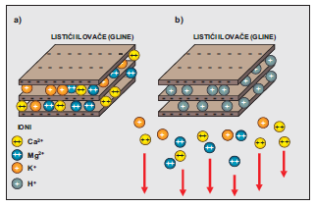
1.10 GLOBAL PROBLEMS CAUSED BY AIR POLLUTION
European Union IPA 2013 Programme for Croatia
Acidification of the atmosphere - acid precipitation
Effects of acidic precipitation on the soil
Cationic change and rinse of nutrients
Cation change a) non-acidified conditions - clay soil with nutrients (metal ions);
b) acidic conditions - the place of ionic metals was captured by hydrogen ionic acids, and the nutrients were washed into deeper layers.

Slide 50
1.10 GLOBAL PROBLEMS CAUSED BY AIR POLLUTION
European Union IPA 2013 Programme for Croatia
Acidification of the atmosphere - acid precipitation
Effects of acidic precipitation on the soil
Mobilization of aluminum
By soil acidification, there is another process in the soil called the mobilization of aluminum and has negative effects on vegetation. Under non-acidified conditions, aluminum ions are present in the soil in the insoluble and non-toxic form of aluminum hydroxide Al (OH)₃. By the time the ground was acidified and pH drops below 5, aluminum ions become soluble in water and as such are toxic to the plant:
Al(OH)₃ + H₂SO₄ Al₂(SO₄)₃ + H₂CO₃

Slide 51
1.10 GLOBAL PROBLEMS CAUSED BY AIR POLLUTION
European Union IPA 2013 Programme for Croatia
Acidification of the atmosphere - acid precipitation
Effects of acidic precipitation on the soil
Mobilization of aluminum
Aluminum sulphate Al₂(SO₄)₃ is soluble in water and releases aluminum ions in the soil. Aluminum ions cause rotting of plant roots and prevent calcium absorption from the roots. The result is slowing the growth of the whole plant. On the other hand, toxic aluminum ions reduce the population of microorganisms in the soil, the role of which is - the degradation of plant residues, such as foliage on forest soil.

Slide 52
1.10 GLOBAL PROBLEMS CAUSED BY AIR POLLUTION
European Union IPA 2013 Programme for Croatia
Acidification of the atmosphere - acid precipitation
Effects of acidic precipitation on the soil
Mobilization of aluminum
Decomposition of plant residues into the soil release metal ions (calcium, potassium, magnesium, etc.) That are used again in the soil as nutrients plants. In acidic conditions, aluminum ions inhibit this process.

Slide 53
1.10 GLOBAL PROBLEMS CAUSED BY AIR POLLUTION
European Union IPA 2013 Programme for Croatia
Acidification of the atmosphere - acid precipitation
The effects of acid precipitation on aquatic ecosystems
The chemical composition of the surface water is a direct indicator of the harmful effects of acid precipitation on aquatic living world. Acidification, water quality significantly decreases because it reduces the capacity of the neutralization, and increases the concentration of aluminium ions.
Surface waters are considered acid if their neutralization capacity is less than zero, corresponding to pH values of water of less than 5.2.

Slide 54
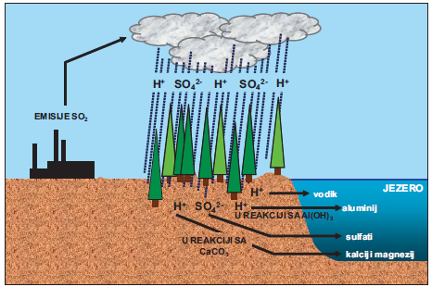
1.10 GLOBAL PROBLEMS CAUSED BY AIR POLLUTION
European Union IPA 2013 Programme for Croatia
Acidification of the atmosphere - acid precipitation
The effects of acid precipitation on aquatic ecosystems
Acidification of lakes begins by returning the reactive intermediates of acid precipitation (SO₄²⁻and H⁺ ions) in the land areas in the vicinity of the lake. Hydrological processes intermediates passing through the soil and rocks where they react with the limestone (CaCO₃) if the rocks are limestone or silicate minerals that contain aluminum. After the chemical reaction on the land, the products of these reactions are flushed out in the lake.

Slide 55
1.10 GLOBAL PROBLEMS CAUSED BY AIR POLLUTION
European Union IPA 2013 Programme for Croatia
Acidification of the atmosphere - acid precipitation
The effects of acid precipitation on aquatic ecosystems
If they are the shore and the bottom of the lake built from limestone, will come to the neutralization of acid because calcium and magnesium have a good buffering capacity. However, if the coast is rich in rocks that contain aluminum-rich silicate minerals, in the lake will be flushed of toxic aluminium.
Increased acidity of water has extremely large effects on wildlife in lakes. Larger animals are well protected from the outside skin and scales, but the internal organs that make up the digestive, respiratory and reproductive system can be damaged by changes the pH of the water.

Slide 56
1.10 GLOBAL PROBLEMS CAUSED BY AIR POLLUTION
European Union IPA 2013 Programme for Croatia
Impact on stratospheric ozone layer
The ozone concentration in the atmosphere is relatively low (in the stratospheric ozone layer 12 000 ppb, and in the troposphere 20 to 100 ppb). Of the total amount of ozone in the atmosphere, as much as 90% is in the stratosphere, with a maximum concentration of 10 ppm at a height of 20 to 25 km from Earth's surface, creating an ozone layer around the planet.
The remaining 10% of ozone is located in the troposphere. Since ozone is very unstable, constantly being broken down and re-created in amount of 300 000 000 tonnes per day.
The year 1930. photochemical processes of creation and the decomposition of ozone in the stratosphere was discovered physicist Sydney Chapman, by which these processes and have received the name – your Chapman cycle.

Slide 57
1.10 GLOBAL PROBLEMS CAUSED BY AIR POLLUTION
European Union IPA 2013 Programme for Croatia
Impact on stratospheric ozone layer
Chapman cycle
1 step: create the oxygen atoms (O) – the decomposition of O₂
O₂ + UV 2O
2. step: the creation of ozone (O₃) – utilization of O₂ and O
O₂ + O O₃
3. step: the decomposition of ozone (O₃) – creation of O₂ and O
O₃ + UV O₂ + O
4 step : create a molecule of oxygen (O₂)
O₃ + O 2O₂
44

Slide 58
1.10 GLOBAL PROBLEMS CAUSED BY AIR POLLUTION
European Union IPA 2013 Programme for Croatia
Impact on stratospheric ozone layer
CHAPMAN-ov CIKLUS
Chapman cycle
45

Slide 59

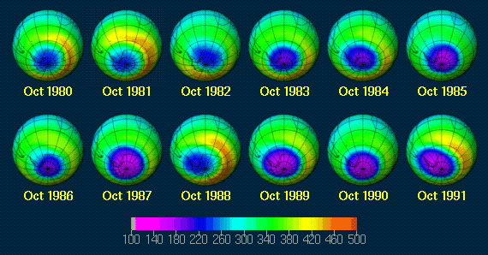
1.10 GLOBAL PROBLEMS CAUSED BY AIR POLLUTION
European Union IPA 2013 Programme for Croatia
Impact on stratospheric ozone layer
OZON LAYER
By reducing the total amount of stratospheric ozone by around 3% in ten years
A SLOW AND LENGTHY PROCESS
Create a ozone hole
46

Slide 60
1.10 GLOBAL PROBLEMS CAUSED BY AIR POLLUTION
European Union IPA 2013 Programme for Croatia
Impact on stratospheric ozone layer
Ozone hole over the Antarctic
For the first time about the existence of an ozone hole in the stratosphere over Antarctica, the world's scientific public was discovered in 1985 when British Antarctic expedition scientists published the results of 30-year total ozone measurements over the Halley Bay Antarctic station.
The results indicated a trend of decreasing the ozone rate since 1975, which amounted to as much as 40% between 1977 and 1984, and continued in the coming years.

Slide 61
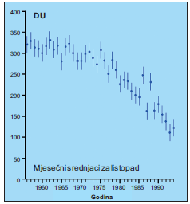
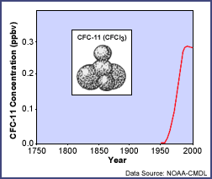
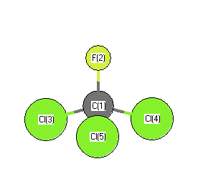
1.10 GLOBAL PROBLEMS CAUSED BY AIR POLLUTION
European Union IPA 2013 Programme for Croatia
Impact on stratospheric ozone layer
Ozone hole over the Antarctic
This dramatically reduces the amount of ozone caused is a newly synthesized compounds CFC-chlorofluoro-carbon
Left: a reduction in the thickness of the ozone layer expressed in Dobson units (DU)
Right: the increase in CFC consumption that matches the drastic decline in ozone

Slide 62
1.10 GLOBAL PROBLEMS CAUSED BY AIR POLLUTION
European Union IPA 2013 Programme for Croatia
Impact on stratospheric ozone layer
Ozone hole over the Antarctic
CFCs used in air conditioning systems, refrigerators, as propellants in the cosmetic and pharmaceutical industry and elsewhere, are discharged in the upper layers of the atmosphere. They are then submerged under the influence of UV radiation from the sun, releasing chlorine atoms (Cl) which then degrade the ozone molecules. There are also compounds that release bromine atoms (Br) which also degrade the ozone molecules. These compounds are called halons.

Slide 63
1.10 GLOBAL PROBLEMS CAUSED BY AIR POLLUTION
European Union IPA 2013 Programme for Croatia
Impact on stratospheric ozone layer
Ozone hole over the Antarctic
The evidence that human activity influence on reducing the thickness of the ozone layer, they're old for over 30 years. Start creating the ozone hole has been linked directly with the increase in production and consumption of CFC-a, as well as their concentrations in the atmosphere. But why the ozone hole began to create just over Antarctica? The answer to this question gives the polar meteorology.

Slide 64
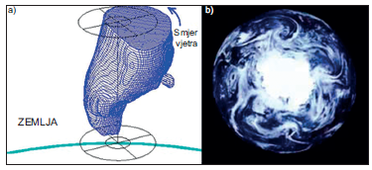
1.10 GLOBAL PROBLEMS CAUSED BY AIR POLLUTION
European Union IPA 2013 Programme for Croatia
Impact on stratospheric ozone layer
Ozone hole over the Antarctic
Namely, over Antarctica are dominated by special meteorological conditions conditions. During the Antarctic winter rays from the Sun do not reach the South Pole and then there is a complete darkness. In addition, there is a circulation of polar air masses known as the "polar vortex" that develop in the lower and middle stratosphere and thermally isolate this area by preventing the entry of warmer air.
The polar vortex over Antarctica a) model; b) satellite image. Source: NASA.

Slide 65
1.10 GLOBAL PROBLEMS CAUSED BY AIR POLLUTION
European Union IPA 2013 Programme for Croatia
Impact on stratospheric ozone layer
Ozone hole over the Antarctic
Due to the mentioned conditions in the polar region, the air temperature drops below -80 ° C and the so-called polar stratospheric clouds. They contain hydrochloric acid (HCl) which reacts with CFC molecules by converting relatively inactive chlorine into more reactive compounds such as, for example, chloronitrate (ClONO₂). In addition to these compounds on the surface of polar stratospheric clouds there are also nitric pentoxide (N₂O₅), nitric acid (HNO₃) and other compounds.

Slide 66
1.10 GLOBAL PROBLEMS CAUSED BY AIR POLLUTION
European Union IPA 2013 Programme for Croatia
Impact on stratospheric ozone layer
Ozone hole over the Antarctic
For damage to the molecules of ozone, chlorine atoms are needed, and they are created with the penetration of the first sun rays in September and October. Under the influence of UV-ray comes to the photodissociation molecule of chlorine (Cl₂) into atoms of chlorine (Cl) in the following reaction:
Cl₂ + hv Cl + Cl
It is exactly this reaction a key reaction that leads to the decomposition of the molecules of ozone, and so to reduce the thickness of the ozone layer over the Antarctic.

Slide 67
1.10 GLOBAL PROBLEMS CAUSED BY AIR POLLUTION
European Union IPA 2013 Programme for Croatia
Impact on stratospheric ozone layer
Ozone damage due to the adverse effects of halogen gases
Halogen gases are gases which contain the atoms of chlorine and bromine, which dropped into the atmosphere to cause the breaking of the molecules of ozone. As a result, damage to the stratospheric ozone layer. In the atmosphere, there are two halogen gas that is emitted from natural sources (oceans and terrestrial ecosystems). These are the methyl chloride (CH₃Cl) and methyl bromide (CH₃Br). Natural sources of these gases emitted in the stratosphere is 16% of chlorine and about 27 to 42% of the bromine. The concentration of bromine and chlorine in the stratosphere that originate from natural sources are not caused by the destruction of the ozone layer.

Slide 68
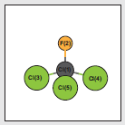
1.10 GLOBAL PROBLEMS CAUSED BY AIR POLLUTION
European Union IPA 2013 Programme for Croatia
Impact on stratospheric ozone layer
Ozone damage due to the adverse effects of halogen gases
By the introduction of new synthesized halogen gases in the 20th century, their large accumulation in the atmosphere results in adverse impacts on the stratospheric ozone layer. Chloro-fluoro-carbon under the commercial name freons was introduced in 1930 in wide use due to its properties: non-toxicity, high stability, non-cancerogenicity and chemical inertian. The first were synthesized trichlorofluoromethane (CFC-11) and dichlorodifluoromethane (CFC-12) used as a substitute for ammonia in refrigerants, as solvents and as propellants.
CFC

Slide 69
1.10 GLOBAL PROBLEMS CAUSED BY AIR POLLUTION
European Union IPA 2013 Programme for Croatia
Impact on stratospheric ozone layer
Ozone damage due to the adverse effects of halogen gases
However, these compounds by diffusion and vertical transporting come to higher parts of the troposphere. Through the discontinuity of the tropopausis, they pass through the stratosphere where the circulation of the lower layers is further swelled. Their damage begins only at 25 km high where UV radiation is sufficiently intense to break the CFC molecule and release chlorine atoms that catalytically destroy ozone.

Slide 70
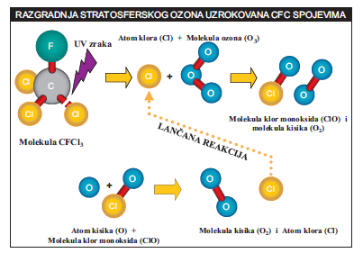
1.10 GLOBAL PROBLEMS CAUSED BY AIR POLLUTION
European Union IPA 2013 Programme for Croatia
Impact on stratospheric ozone layer
Ozone damage due to the adverse effects of halogen gases
Phase 1: CFC photolysis in the stratosphere
In the first stage comes to break up of molecules CFC by UV-rays from the Sun's spectrum. In this reaction from a CFC molecule frees the chlorine atom:
CFCl₃ + hv CFCl₂ + Cl
Phase 2: Catalytic ozone depletion The released chlorine atom in the reaction with ozone breaks the ozone molecule on chlorine oxide and oxygen molecule:
Cl + O₃ ClO + O₂
In reaction of chlorine oxide with ozone there is a formation of chlorine atoms and 2 oxygen molecules:
ClO + O₃ Cl + 2O₂

Slide 71
1.10 GLOBAL PROBLEMS CAUSED BY AIR POLLUTION
European Union IPA 2013 Programme for Croatia
Impact on stratospheric ozone layer
Ozone damage due to the adverse effects of halogen gases
It is necessary to note that in the above reactions out of every 2 molecules of ozone occur 3 molecules of oxygen. The catalyst in these reactions is the atom of chlorine that is in the second reaction re-created and begins the process of second stage from the beginning.
In fact, every atom of chlorine can destroy hundreds of thousands of molecules of ozone.

Slide 72
1.10 GLOBAL PROBLEMS CAUSED BY AIR POLLUTION
European Union IPA 2013 Programme for Croatia
Impact on stratospheric ozone layer
Ozone damage due to the adverse effects of halogen gases
Halogen compounds are very long retained in the atmosphere (between 20 to 100 years) and for that reason is their great accumulation. It was calculated that after the first generation of halogen compounds were prohibited under the Montreal Protocol, their concentration in the atmosphere will be reduced to 1980 levels until 2050, and in polar regions where the accumulation was the largest, only in 2065. Each of these compounds has its potential damage to the ozone layer (ODP – Ozone Depletion Potential). So ODP for CFC-11 is 1.0, while the other CFC compounds have ODP between 0.01 to 1. Halons have ODP higher than 10.

Slide 73
1.10 GLOBAL PROBLEMS CAUSED BY AIR POLLUTION
European Union IPA 2013 Programme for Croatia
Impact on stratospheric ozone layer
Ozone damage due to the adverse effects of halogen gases
According to the degree of ozone depletion (ODP), the US Environmental Protection Agency (EPA) categorized the compounds into two groups:
• compounds of group 1 having ODP 0.2 or greater (chloro-fluoro-carbon, carbon tetrachloride, halons, methyl bromide, methyl chloroform)
• compounds of group 2 having ODP less than 0.2 (chloro-fluoro-hydrocarbons)

Slide 74
1.10 GLOBAL PROBLEMS CAUSED BY AIR POLLUTION
European Union IPA 2013 Programme for Croatia
Impact on stratospheric ozone layer
Biological effects of reducing the thickness of the stratospheric ozone layer
Very high risk for human health due to its genotoxic, mutagenic, carcinogenic and immunotoxic properties is ultraviolet (UV) radiation. The biological effect of UV-radiation is the result of absorption of energy by the tissue. Electromagnetic rays through the tissue cause it to warm up.

Slide 75
1.10 GLOBAL PROBLEMS CAUSED BY AIR POLLUTION
European Union IPA 2013 Programme for Croatia
Impact on stratospheric ozone layer
Biological effects of reducing the thickness of the stratospheric ozone layer
Increasing molecular energy as a result of absorption of UV radiation is the cause of free radical formation that leads to photochemical and abiotic tissue damage. The degree of damage to the tissue depends on the radiation dose, and the speed of repair of tissue in the process. Radiation damage does not manifest suddenly but has cumulative effect.

Slide 76
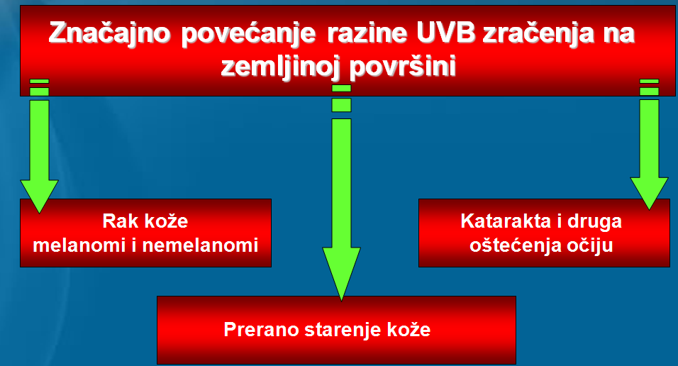
1.10 GLOBAL PROBLEMS CAUSED BY AIR POLLUTION
European Union IPA 2013 Programme for Croatia
Impact on stratospheric ozone layer
Biological effects of reducing the thickness of the stratospheric ozone layer
Significantly increasing the level of UVB radiation on Earth's surface
Skin cancer melanomas and nonmelanomas
Cataracts and other eye damage
Premature skin aging
52

Slide 77
THANK YOU FOR YOUR ATTENTION !
Disclaimer: The contents of this publication are the sole responsibility of EKONERG – Energy Research and Environmental Protection Institute, Ltd. and can in no way be taken to reflect the views of the European Union
This project is funded by the European Union

